Slide 1
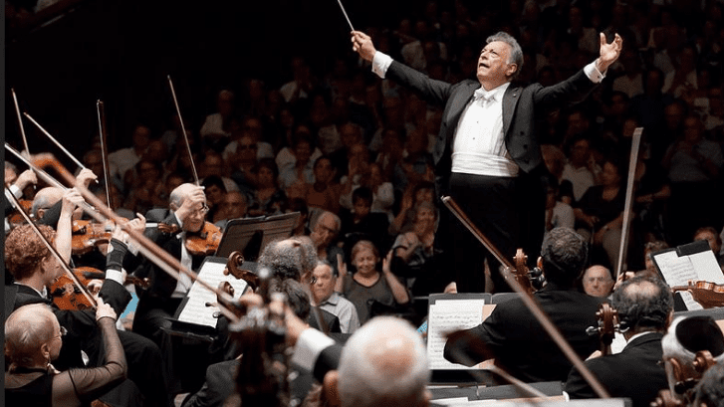
Role of the
Staffing Function
Staffing is the process of filling positions/posts in the organisation with adequate and qualified personnel
Staffing is the process of acquiring, deploying, and retaining a workforce of sufficient quantity and quality to create positive impacts on the organisation's effectiveness

Slide 2

Staff Function
Staffing is the process of filling positions/posts in the organisation with adequate and qualified personnel
Staffing is the process of acquiring, deploying, and retaining a workforce of sufficient quantity and quality to create positive impacts on the organisation's effectiveness

Slide 3

Perspective
De re Rustica, 1 AD, Columella – outlined guidelines for the treatment and management of slaves.
  ‘People will respond most positively, he reasoned, if you treat them well and give them some promise of reward. “Such justice and consideration on the part of the owner contributes greatly to the increase of his estate.”

Slide 4
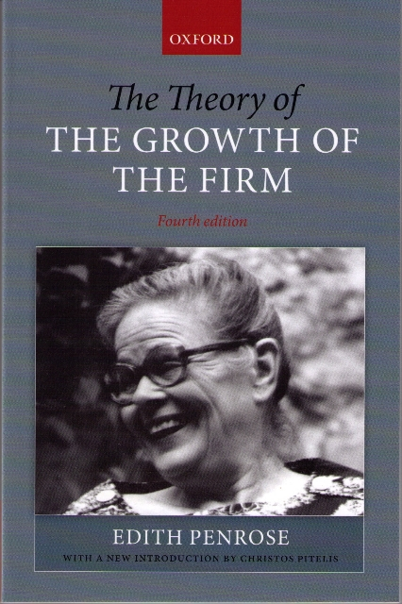
The Growth of the Firm (Penrose)
“There are also human resources available in a firm – unskilled and skilled labour, clerical, administrative, financial, legal, technical and managerial staff. Some employees are hired on long-term contracts and may represent a substantial investment on the part of the firm. For some purposes these can be treated as more or less fixed or durable resources, like plant or equipment; even though they are not ‘owned’ by the firm, the firm suffers a loss akin to a capital loss when such employees leave the firm at the height of their abilities.” Penrose ([1959], 1995 : 24)

Slide 5
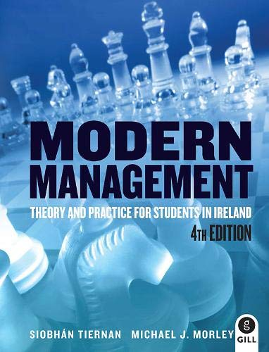
Staffing Function Definition
“The managerial function of staffing involves managing the organisation structure through proper and effective selection, appraisal and development of personnel to fill the roles designed into the structure.” Koontz and O’Donnell (1972)
“Staffing is the function by which managers build an organisation through the recruitment, selection, development, of individuals as capable employees. The staffing function of management consists of few interrelated activities such as planning of human resource, recruitment, selection, placement, training and development, remuneration, performance appraisal, promotion and transfers. All these activities make up the elements of the process of staffing.” McFarland (1979)

Slide 6

Features of the Staffing Function
Pervasive
Dynamic
Scope

Slide 7

Objectives of the Staffing Function
To understand all function of staffing in an organisation
To understand manpower planning so that people are available at right time and at a right place.
To understand issues related to job analysis and to overcome the problem

Slide 8
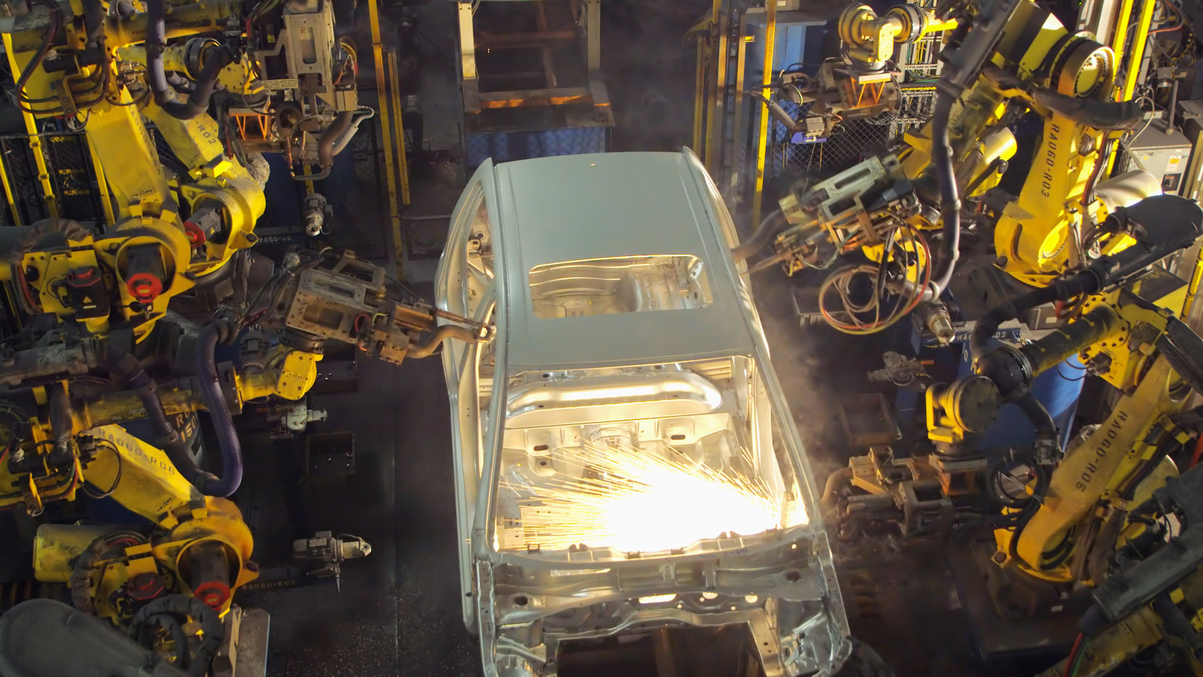
Tasks
Training & Development
Effective co-ordination
Effective recruitment & placement
Building effective human resources
Optimum use of resources
Enhances corporate image
Job satisfaction
Manpower planning
Job analysis
Performance appraisal

Slide 9

Scope
Manpower planning
Job analysis
Recruitment & Selection
Training & Development
Performance appraisal
Tasks
Hiring
Motivation
Employee maintenance
Human relations

Slide 10

Internal Factors Affecting Staffing
Best Companies to work for - Irish Independent
Corporate Image
Corporate Culture
Size of the Organization
Strategy
Leadership
HR Policy
Training
Reward
Industrial Relations

Slide 11

Macro-Factors Affecting Staffing (Uncertainty)
Brexit
Covid
Economic recession
Teleworking
Equality
Childcare

Slide 12
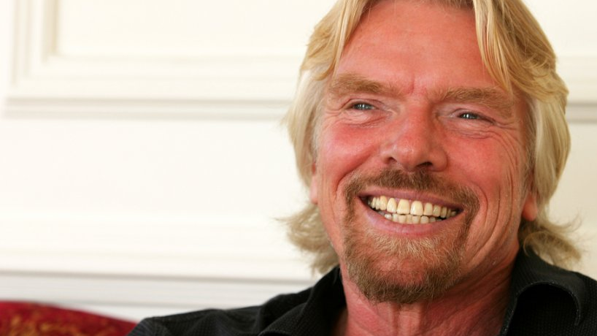
Investing in People
Demonstrate the organisations commitment to training and development
Help the organisation in its recruitment and retention practices
Provide a framework of developing the organisation’s skill-base
“Train people well enough so they can leave, treat them well enough so they don’t want to.” Richard Branson

Slide 13
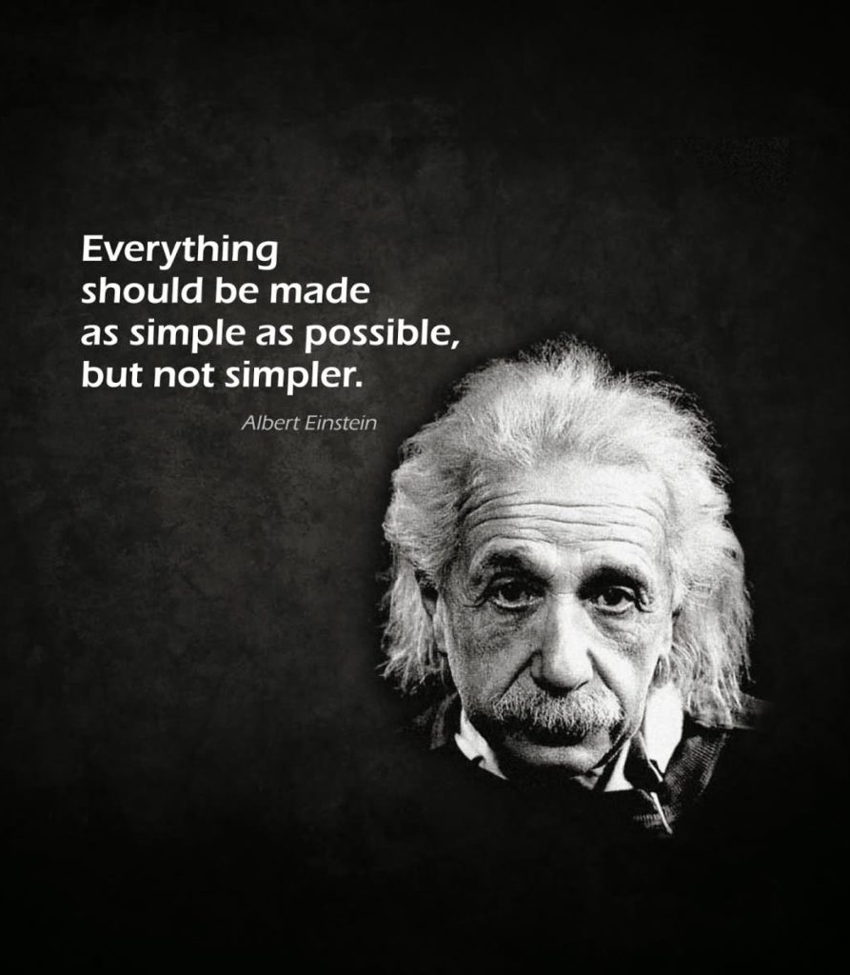
Investing in People
Commitment from the top to develop all employees to achieve the organisation’s business objectives
Planning – regular reviews of needs and planning of the training and development of all employees
Action to train and develop individuals on recruitment and throughout their employment
Evaluation of the investment in training and development to assess achievement and improve its future effectiveness

Slide 14
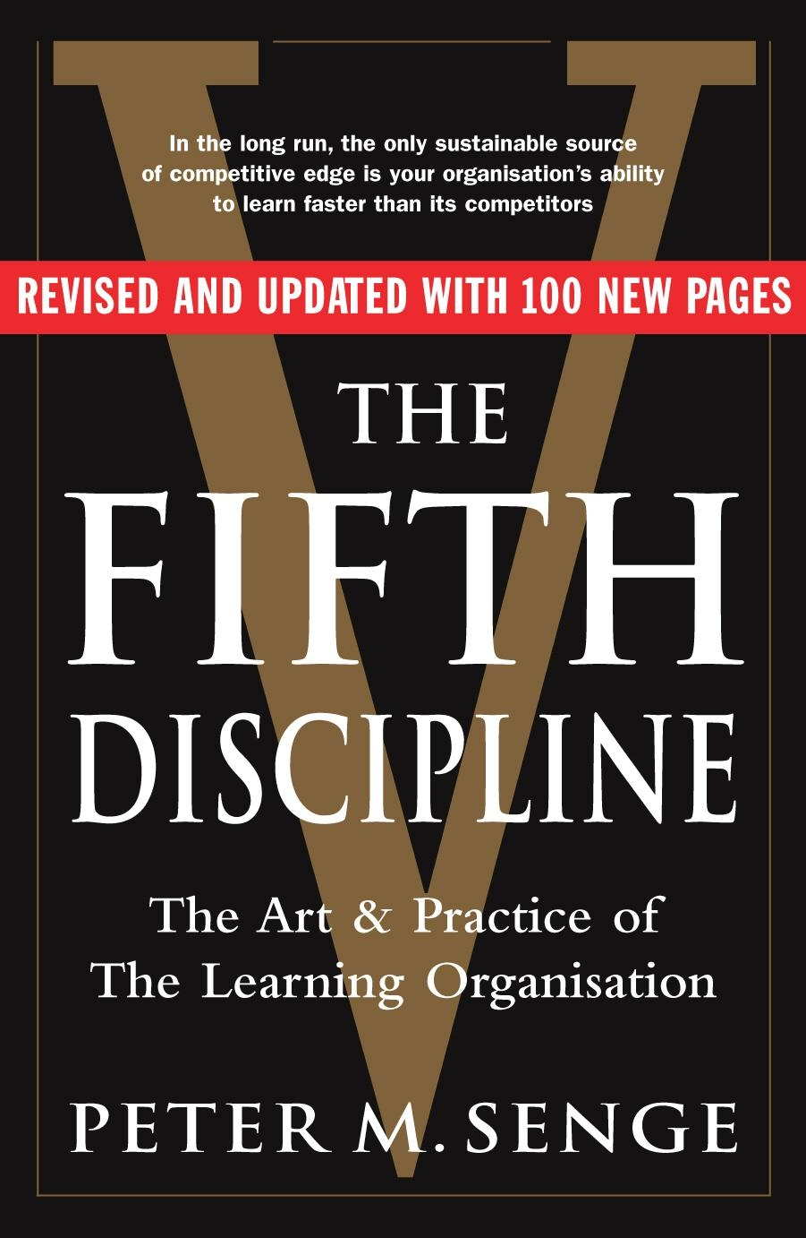
Learning Organisation
An organisation that is capable of continual regeneration from the variety of knowledge, experience and skills within a culture that encourages questioning and challenge
Organisation Learning interventions emphasise the structures and social processes that enable employees and teams to learn and share knowledge
Knowledge Learning focuses on the tools and techniques that enable organisations to collect, organise, and translate information into useful knowledge

Slide 15
The Fifth Disciple (Senge)
The Learning Organisation
Building Shared Vision
Mental Models
Personal Mastery
System Thinking
Team Learning

Slide 16
Organisation Learning: An Integrative Framework
Organisation Learning
Knowledge Management
Competitive
Strategy
Organisation Characteristics
Structure
Information
Systems
HR Practices
Culture
Leadership
Organisation Learning Processes
Discovery
Invention
Production
Generalization
Organisation Knowledge
Tacit
Explicit
Organisation
Performance

Slide 17
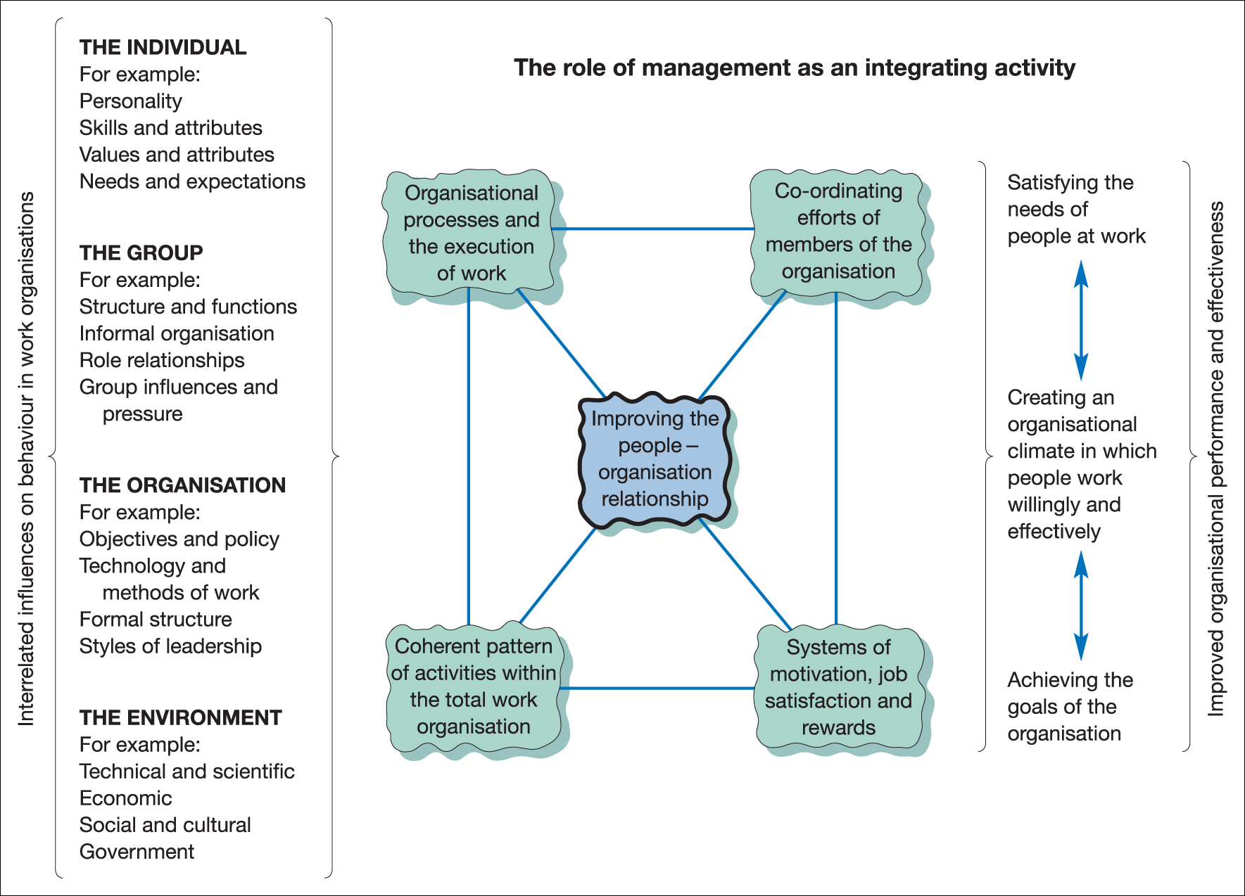
Management as an Integrating Activity
Figure 1.6 Management as the cornerstone of organisational effectiveness

Slide 18

Learning Organisation Characteristics
Structures emphasise teamwork, information sharing, empowerment
Information systems facilitate rapid acquisition and sharing of complex information to manage knowledge for competitive advantage
Human resources reinforce new skills and knowledge
Organisation culture encourages innovation
Leaders model openness and freedom to try new things while communicating a compelling vision

Slide 19

Organisation Learning Processes
Single Loop Learning
    Most common form of learning
    Aimed at adapting and improving the status quo
Double Loop Learning
    Generative learning
    Questions and changes existing assumptions and conditions
Deutero learning
    Learning how to learn
    Learning how to improve single and double loop learning

Slide 20

Knowledge & Performance
Organisation knowledge must be relevant and applied effectively to the competitive strategy
Link organisation learning processes to organisation performance
Growing emphasis on the value of intellectual assets and services

Slide 21

Knowledge Management Interventions
Generating Knowledge
    Identify knowledge for competitive strategy
    Develop ways to acquire or create that knowledge
  Organising knowledge
    Put knowledge into a usable form
    Codification & personalization
  Distributing knowledge
    Making knowledge easy to access, use & reuse

Slide 22

Groups & Teams
Learning Objectives
Explain why groups and teams are key contributors to organisational effectiveness
Identify the different types of groups and teams that help managers and organisations achieve their goals
Explain how different elements of group dynamics influence the functioning and effectiveness of groups and teams
Explain why it is important for groups and teams to have a balance of conformity and deviance and a moderate level of cohesiveness
Describe how managers can motivate group members to achieve organisational goals and reduce social loafing in groups and teams

Slide 23
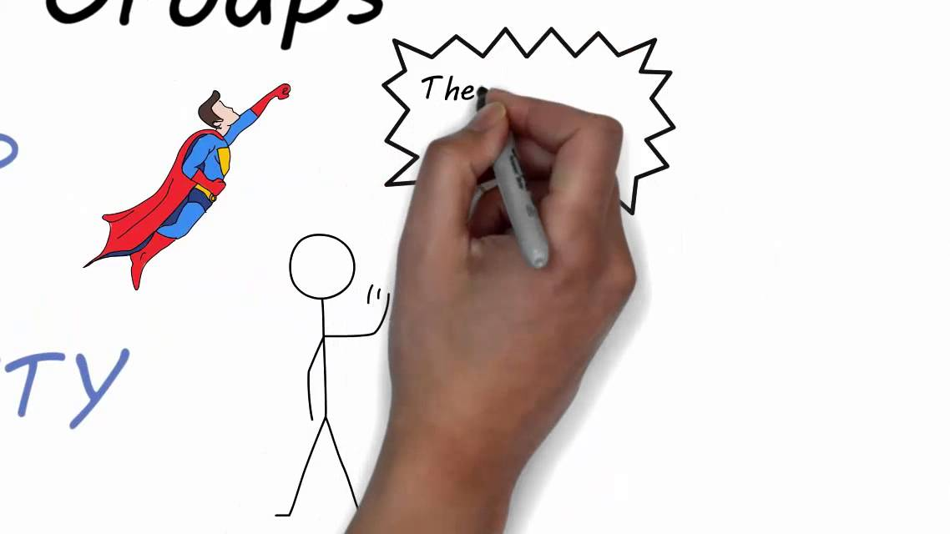
Teams versus Groups https://www.youtube.com/watch?v=uG-FLOi4OOU

Slide 24
Groups & Teams
GROUP
People working towards a goal whose work is coordinated by someone else (e.g. a manager) for them
TEAM
People working towards a common goal who coordinate their work amongst themselves

Slide 25
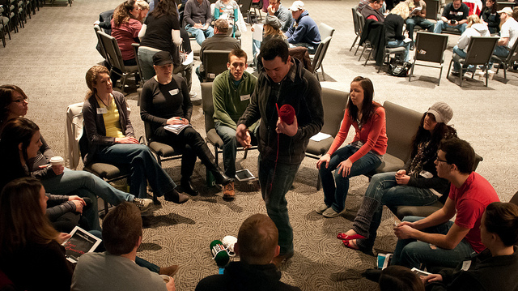
Groups, Teams &
Organisational Effectiveness
Group
    Two or more people who interact with each other to accomplish certain goals or meet certain needs

Slide 26
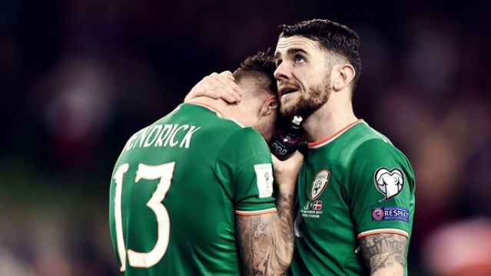
Groups, Teams &
Organisational Effectiveness
Team
    A group whose members work intensely with each other to achieve a specific, common goal or objective
  All teams are groups but not all groups are teams
  Teams often are difficult to form
  It takes time for members to learn how to work together

Slide 27
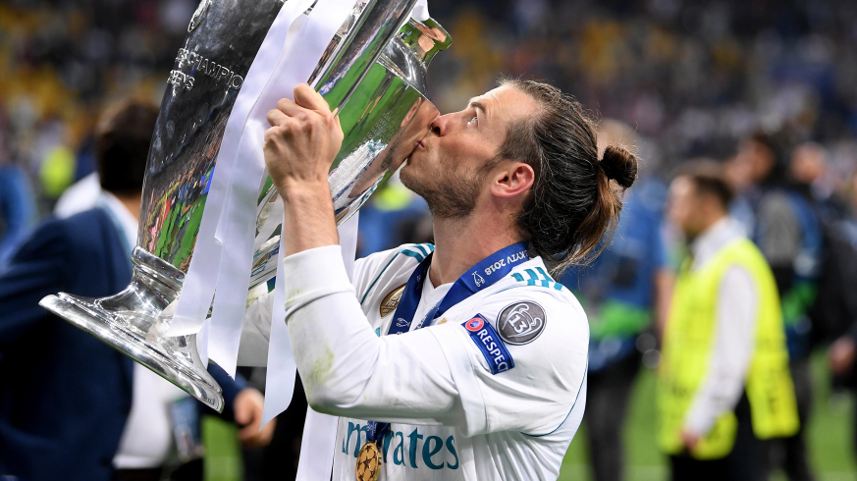
Groups, Teams &
Organisational Effectiveness
Two characteristics distinguish teams from groups
  Intensity with which team members work together
  Presence of a specific, overriding team goal or objective

Slide 28
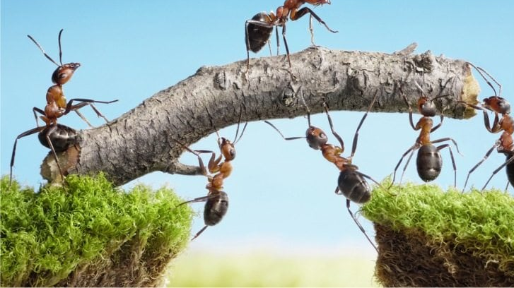
Groups & Teams as
Performance Enhancers
Advantage of synergy
  People working in a group can produce more outputs than would have been produced if each person had worked separately

Slide 29
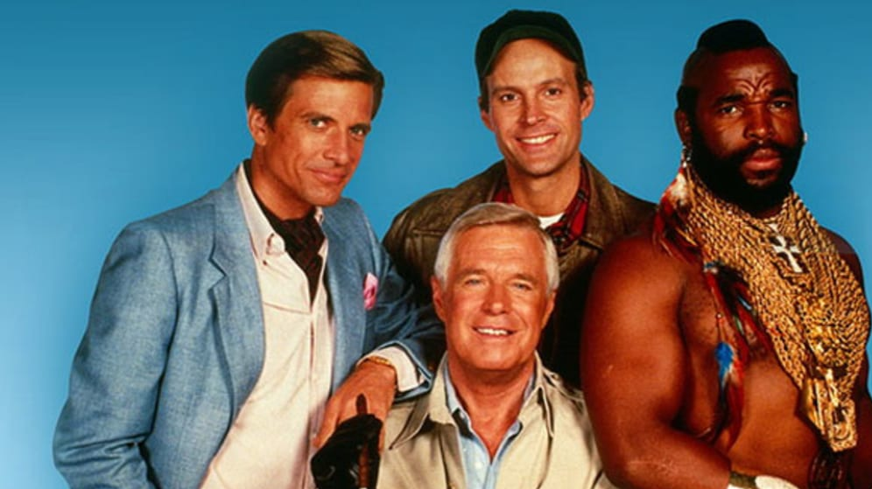
Groups & Teams as
Performance Enhancers
Factors that contribute to synergy
  Ability of group members to bounce ideas off one another
  To correct one another’s mistakes
  To bring a diverse knowledge base to bear on a problem
  To accomplish work that is too vast for any one individual to achieve
To take advantage of the potential for synergy, managers need to make sure groups are composed of members who have complementary skills and knowledge relevant to the group’s work

Slide 30
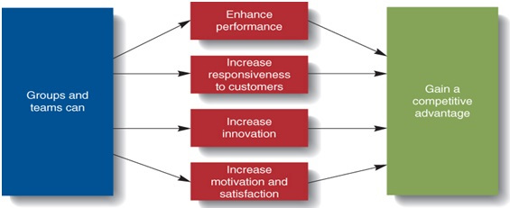
Groups’ & Teams’ Contributions to
Organisational Effectiveness

Slide 31
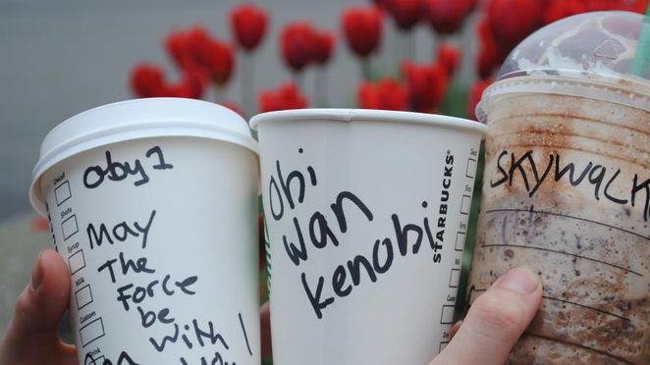
Groups & Teams and
Responsiveness to Customers
Difficult to achieve given the many constraints such as ssafety issues, regulations, costs
Cross-functional teams can provide the wide variety of skills needed to meet customer demands
  Teams consist of members of different departments

Slide 32

Teams & Innovation
Innovation
  The creative development of new products, new technologies, new services, or new organisational structures
  Individuals rarely possess the wide variety of skills needed for successful innovation
  Team members can uncover each other’s flaws and balance each other’s strengths and weaknesses
  Managers should empower the team and make it accountable for the innovation process

Slide 33
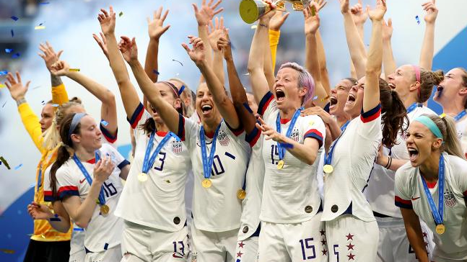
Groups & Teams as Motivators
Members of groups, and particularly teams, are often better motivated and satisfied than individuals
  Team members are more motivated and satisfied than if they were working alone
  Team members can see the effect of their contribution to achieving team and organisational goals
  Teams provide needed social interaction and help employees cope with work-related stressors

Slide 34
Types of Groups & Teams in Organisations
Groups & Teams
Formal Groups and Teams created by management
Cross-Functional Teams
Cross-Cultural Teams
Top-management teams
Research & Development Teams
Command Groups
Task Forces
Informal Groups created by organisation members
Friendship Groups
Interest Groups

Slide 35

Types of
Groups & Teams
Formal Group
  A group that managers establish to achieve organisational goals
Cross-functional Teams
  composed of members from different departments
Cross-cultural Teams
  composed of members from different cultures or countries
https://youtu.be/jPfHpYHaUUk

Slide 36
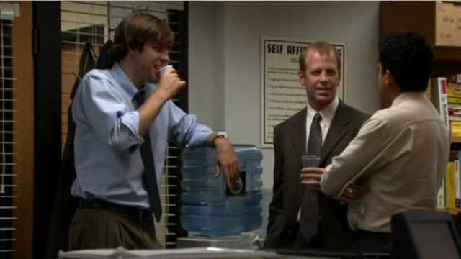
Types of
Groups & Teams
Informal Group
  A group that managers or non-managerial employees form to help achieve their own goals or to meet their own needs

Slide 37
Types of Groups & Teams
Type of Team
Top-management Team | A group composed of the CEO, president, and the heads of the most important departments.
Research & Development Team | A team whose members havethe expertise and experience needed to develop new products.
Command Groups | A group composed of subordinates who report to the same supervisor, also called a department or unit.
Task Forces | A committe of managers or non-managerial employees from various departments or divisions who meet to solve specific, mutual problem; also called an “adhoc committee”.
Self-managed Work Team | A group of employees who supervise their own activities and monitor the quality of the goods and services they provide.
Virtual Team | A team whose members rarely or never meet face-to-face and interact by using various forms of information technology such as email, computer networking, telephone and online conferences.
Friendship Group | An informal group composed of employees who enjoy each other’s company and socialise with each other.
Interest Group | An informal group composes of employees seeking to achieve a common goal related to their membership in an organisation.

Slide 38

Self-Managed Work Teams
Keys to effective self managed teams:
    Give the team enough responsibility and autonomy to be self-managing
    The team’s task should be complex enough to include many different steps
    Select members carefully for their diversity, skills, and enthusiasm
    Managers should guide and coach, not supervise
    Determine training needs and be sure it is provided

Slide 39
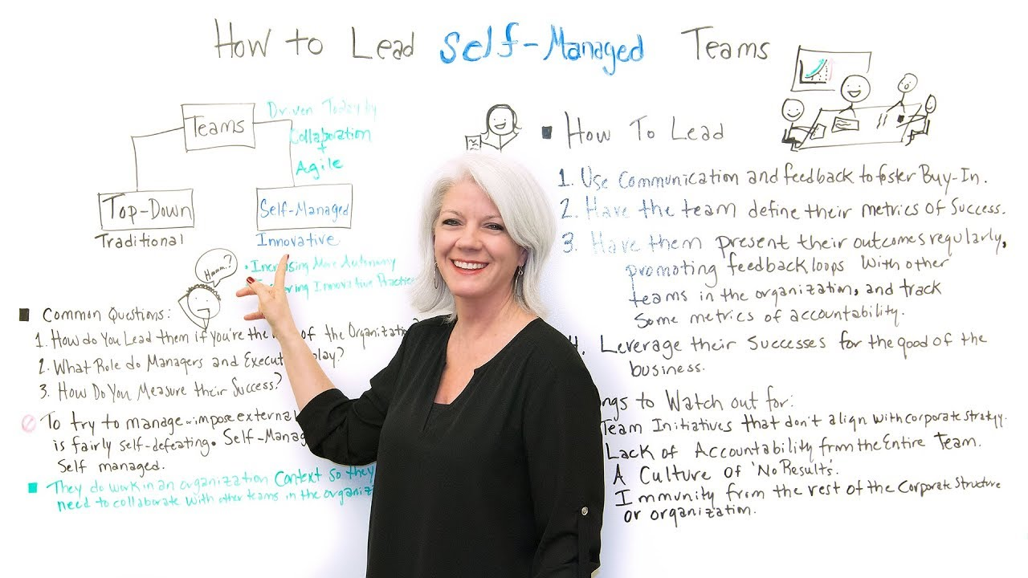
Self-Managed Work Teams https://www.youtube.com/watch?v=fypfjVuOMKE

Slide 40

Virtual Teams
Members rarely meet face-to-face
Interact by using various forms of information technology
Email, computer networks, telephone, and online conferences

Slide 41
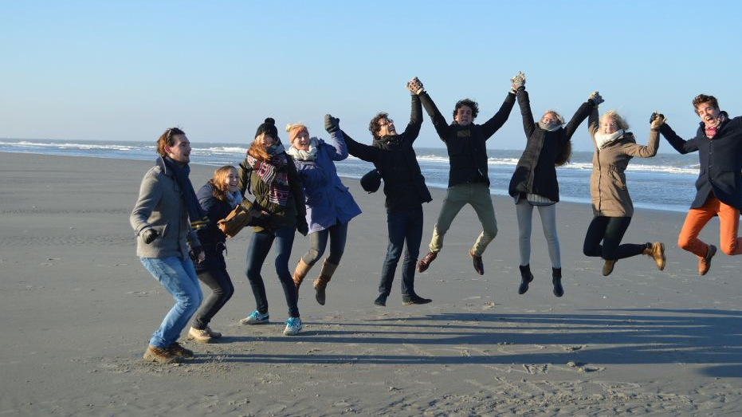
Groups
Friendship Groups
      An informal group composed of employees who enjoy one another’s company and socialize with one another
Interest Groups
      An informal group of employees seeking to achieve a common goal related to their membership in an organisation

Slide 42

Group Size
Advantage of small groups
    Interact more with each other and easier to coordinate their efforts
    More motivated, satisfied, and committed
    Easier to share information
    Better able to see the importance of their personal contributions

Slide 43
Large Groups Advantages & Disadvantages
Advantages
More resources at their disposal to achieve group goals
Enables managers to obtain division of labour advantages
Disadvantages
Problem of communication and co-ordination
Lower level of motivation
Members might not think their efforts are really needed

Slide 44

Group Tasks
Group tasks impact how a group interacts
Task interdependence shows how the work of one member impacts another; as interdependence rises, members must work more closely together

Slide 45
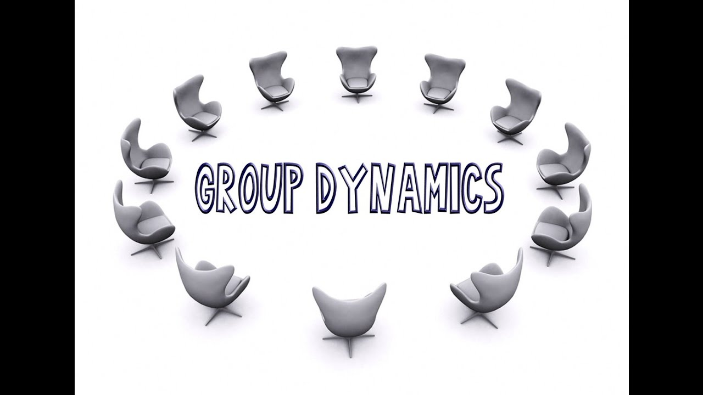
Understanding Group Dynamics https://youtu.be/uL6x99-VSBA

Slide 46
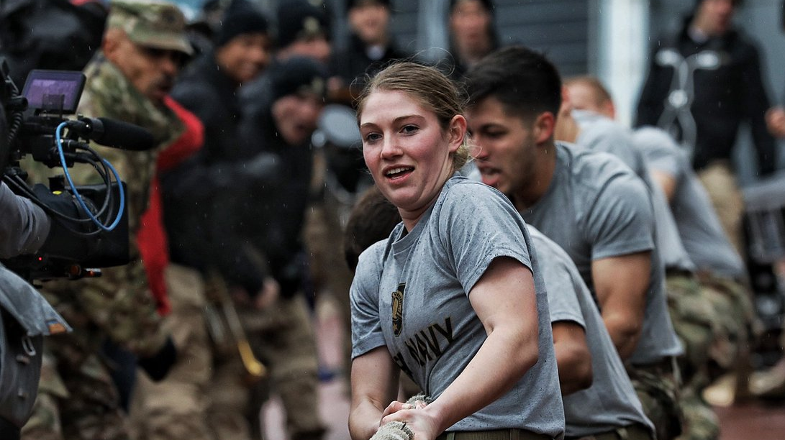
Group Dynamics (Interdependence)
Pooled
    Members make separate, independent contributions to group such that group performance is the sum of each member’s contributions
Reciprocal
    Work performed by one group member is mutually dependent on work done by other members
Sequential
    Members perform tasks in a sequential order making it difficult to determine individual performance since one member depends on another

Slide 47
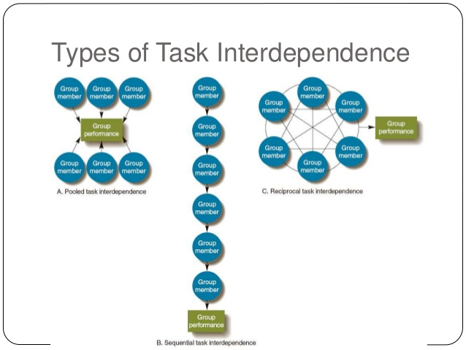
Types of Task Interdependence

Slide 48

Group Roles
The set of behaviours and tasks that a group member is expected to perform because of his or her position in the group
In cross-functional teams, members are expected to perform roles in their specialty
Managers should clearly describe expected roles to group members when they are assigned to the group
Role-making occurs as workers take on more responsibility in their roles as group members
Self-managed teams may assign the roles to members themselves

Slide 49

Group Leadership
  Effective leadership is a key ingredient in high performing groups, teams, and organisations
  Formal groups created by an organisation have a leader appointed by the organisation
  Groups that evolve independently in an organisation have an informal leader recognised by the group

Slide 50
Stages of Group Development
Forming
Storming
Norming
Performing
Adjourning

Slide 51
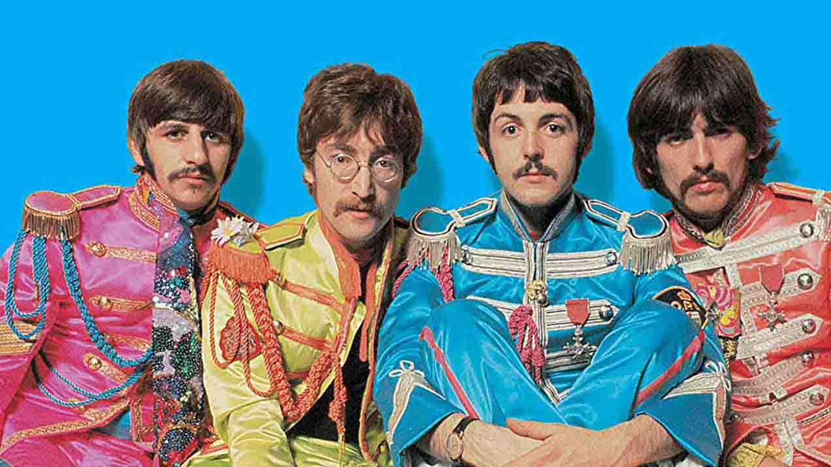
Stages of Group Development
Forming
    Group members get to know each other and reach common goals
Storming
    Group members disagree on direction and leadership. Managers need to be sure the conflict stays focused
Norming
    Close ties and consensus begin to develop between group members
Performing
    The group begins to do its real work
Adjourning
    Only for task forces that are temporary
Note - these steps take time!

Slide 52
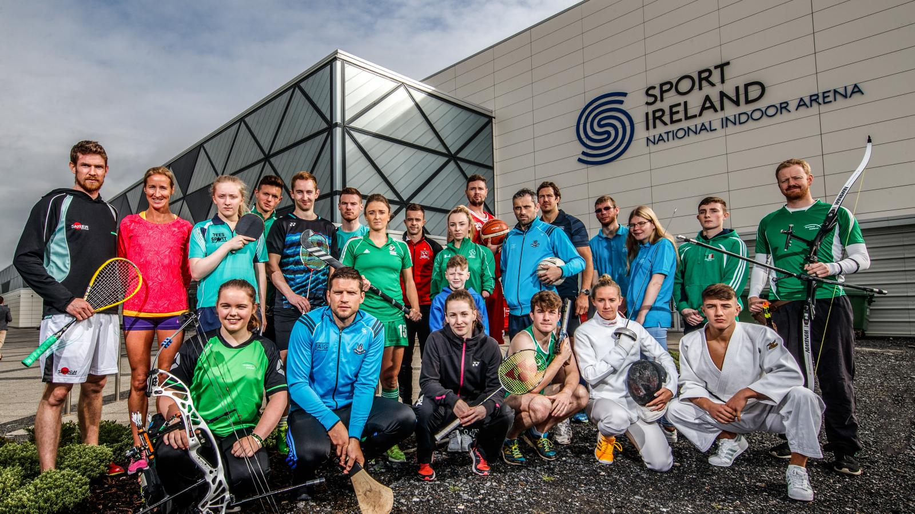
Tuckman Model: Understanding the Stages of Team Formation https://youtu.be/2QbXc6E08H4

Slide 53
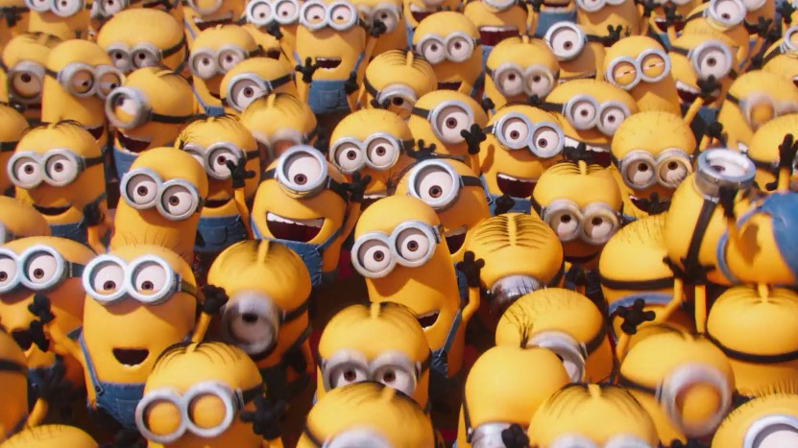
Group Norms
  Shared guidelines or rules for behaviour that most group members follow
  Managers should encourage members to develop norms that contribute to group performance and the attainment of group goals

Slide 54
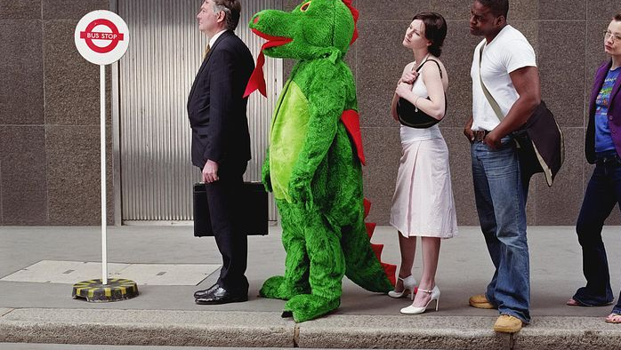
Group Dynamics
Conformity and Deviance
Members conform to norms to obtain rewards, imitate respected members, and because they feel the behaviour is right
When a member deviates, other members will try to make them conform, expel the member, or change the group norms to accommodate them
Conformity and deviance must be balanced for high performance from the group
Deviance allows for new ideas in the group
Asch Conformity Experiments (1950)
https://www.khanacademy.org/test-prep/mcat/behavior/social-psychology/v/asch-conformity-studies-asch-line-studies

Slide 55
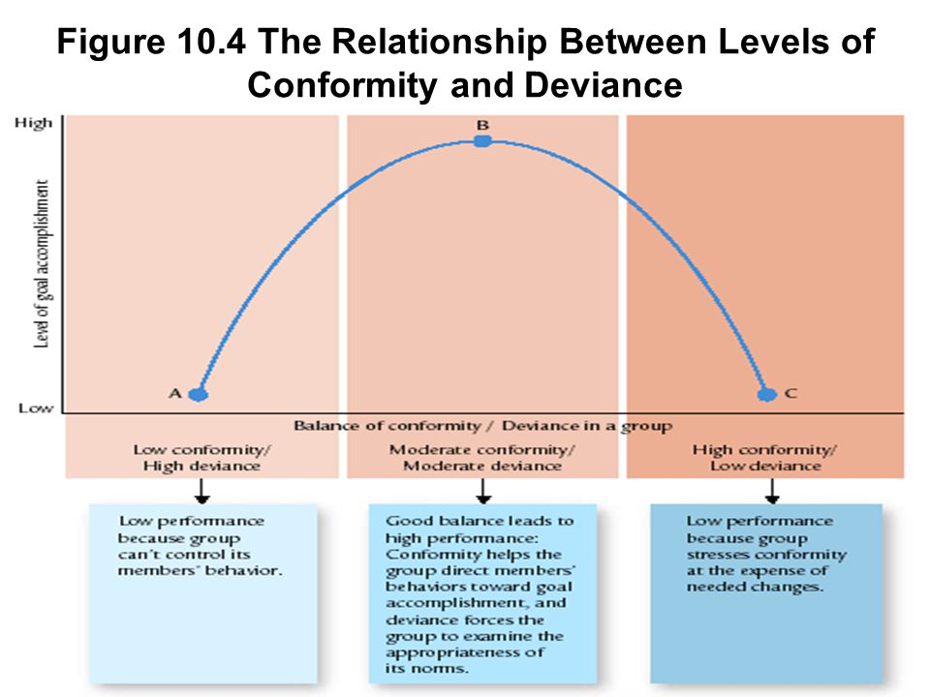
Balancing Conformity & Deviance in Groups

Slide 56
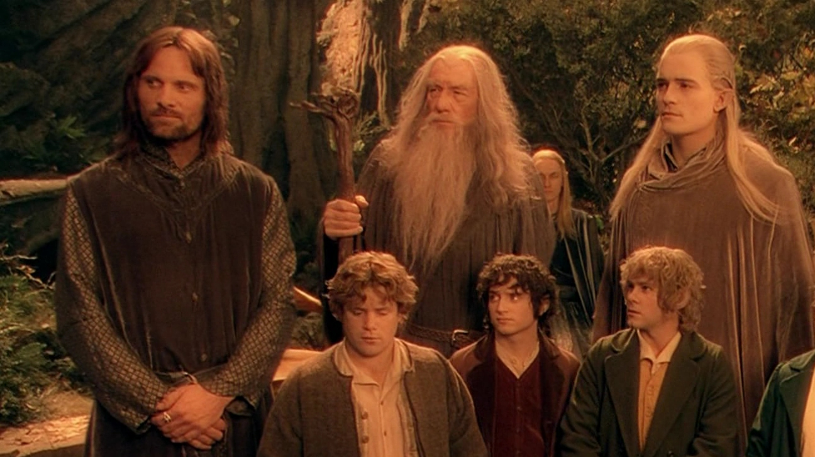
Group Cohesiveness
  The degree to which members are attracted to their group
  Three major consequences
    Level of participation
    Level of conformity to group norms
    Emphasis on group goal accomplishment

Slide 57
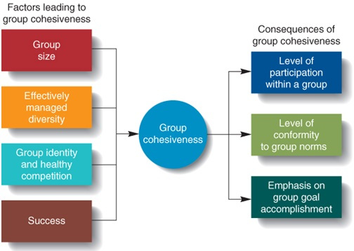
Sources & Consequences of Group Cohesiveness

Slide 58
Factors Leading to Group Cohesiveness
Factor
Group Size | Smaller groups allow for high cohesiveness; low cohesiveness groups with many members can benefit from splitting into two groups
Managed Diversity | Diverse groups often come up with better solutions
Group Identity | Encouraging a group to adopt a unique identity and engage in competition with others can increase cohesiveness
Success | Cohesiveness increases with success; finding ways for a group to have some small successes increases cohesiveness

Slide 59
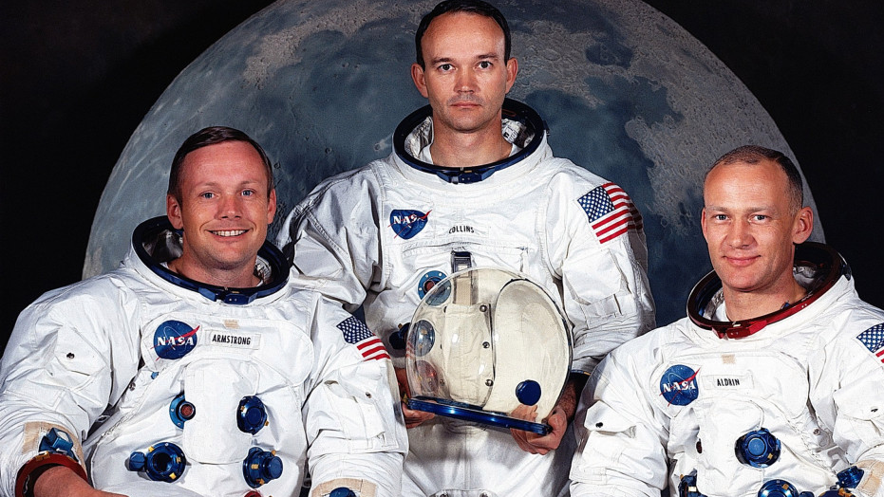
High Performance
Managing Groups & Teams
Motivating group members to achieve organisational goals:
    Members should benefit when the group performs well—rewards can be monetary or in other forms such as special recognition
    Individual compensation is a combination of both individual and group performance
    Make additional resources (beyond compensation) such as choice assignments available to high-performance groups
  Apollo 11

Slide 60

High Performance
Managing Groups & Teams
Social loafing
The human tendency to put forth less effort in a group than individually
Results in possibly lower group performance and failure to attain group goals
https://youtu.be/7nzCEGN8eJM

Slide 61
Three Ways to Reduce Social Loafing
Reduce
Making individual contributions toa group identifiable when possible
Emphasising the valuable contributions of individuals members
Keeping group size at an appropriate level

Slide 62
Solo & Team Leadership (Belbin, 1993)
Solo Leader | Team Leader
Plays a limited role – interferes in everything | Choses to limit role to team roles – delegates roles to others
Strives for conformity – tries to mould people to particular standards | Builds on diversity – values diversity in people
Collects acolytes – collects and admirers and sycophants | Seeks talent – is not threatened by people with special abilities
Directs subordinates – subordinates take their leads and cues from the leader | Develops colleagues – encourages the growth of personal strength
Project delivers – makes it clear what everyone is supposed to do. Chooses to limit roles to preferred teams – delegates roles to others | Creates mission – projects the vision which others can act on as they see fit

Slide 63

Team Leadership (Belbin)
The composition of the team is important – individual differences in style, role, and contribution were a source of team strength
An individual with clear, useful, and appreciated attributes would fit into a team on the basis of their strengths
These individuals also brought weaknesses and are a price worth paying for their contribution to the team “Allowable weaknesses”
There is no ideal team member
https://youtu.be/-efhOLVgEvM

Slide 64
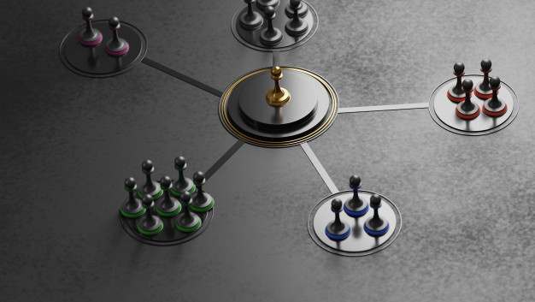
Network Interventions
Involves three or more companies joined together for a common purpose
Each organisation in the network has goals related to the network as well as those focused on self-interest
Characterised by two types of change:
    Creating the initial network (transorganisational development)
    Managing change within an established network

Slide 65
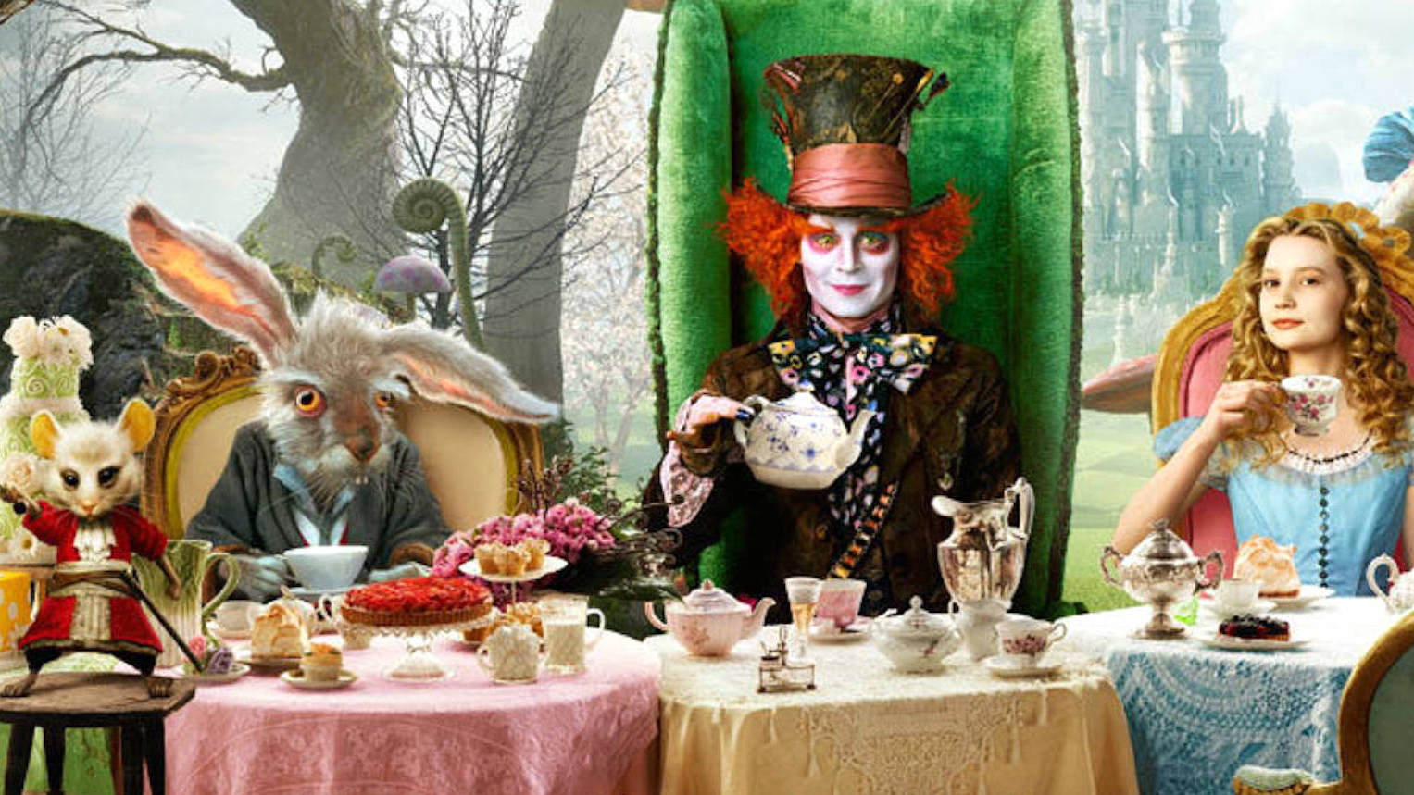
Context
The extent to which meaning in communication is carried in the words
Organisations in high context cultures tend to value ceremony and ritual, the structure is less formal, there are fewer written policies, and people are often late for appointments

Slide 66
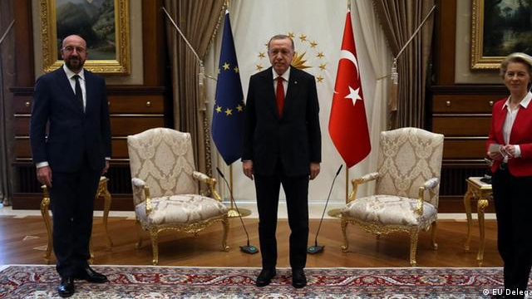
Power Distance
Extent to which members of a society accept that status and power are distributed unequally in an organisation
Organisations in these cultures tend to be autocratic, possess clear status differences, and have little employee participation
Turkey has denied being disrespectful to the head of the European Commission (Ursula Von Der Leyen) 09/04/2021, World Today News

Slide 67
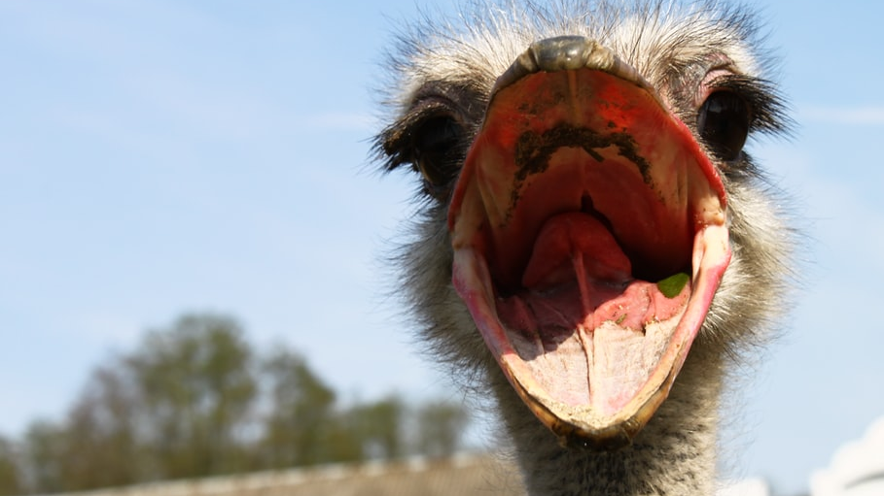
Avoidance
The extent to which members of a society tolerate the unfamiliar and unpredictable
Organisations in these cultures tend to
    Value experts
    Prefer clear roles
    Avoid conflict
    Resist change

Slide 68
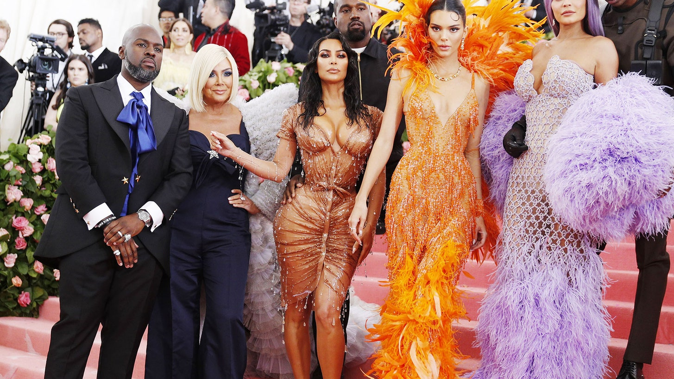
Achievement Orientation
The extent to which people in a society value assertiveness and the acquisition of material goods
Organisations in these cultures tend to associate achievement with wealth and recognition, value decisiveness, and gender roles are clearly differentiated

Slide 69
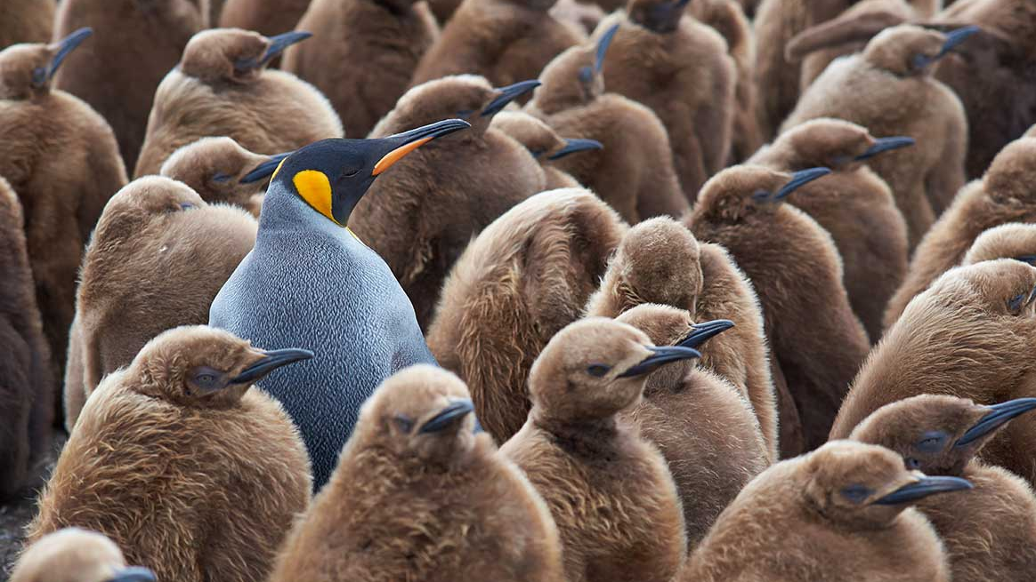
Individualism
The extent to which people in a society believe they should be responsible for themselves and their immediate family
Organisations in these cultures tend to encourage personal initiative, value time and autonomy, accept competition, and autonomy is highly valued

Slide 70
Johnson & Scholes Cultural Web (1992)
What past events people talk about inside and outside the organisation success or failures. Who and what are heroes/heroines?
The Paradigm
Stories
Rituals & Routines
Symbols
Power Structures
Organisational Structures
Control Systems
Internal control systems such as finance, performance quality and rewards/salaries tec.
Organisational ‘semiotics’ including, logos, how grand the offices are, plus formal or informal dress codes
This includes the formal organisational structure, and relationship s that dictate whose contributions are most valued.
Behaviour and rules that signal importance. So what’s supposed to happen in given situations and what’s valued by management.
Pockets of real power and influence over decisions, operations and direction. This can include social power.

Slide 71
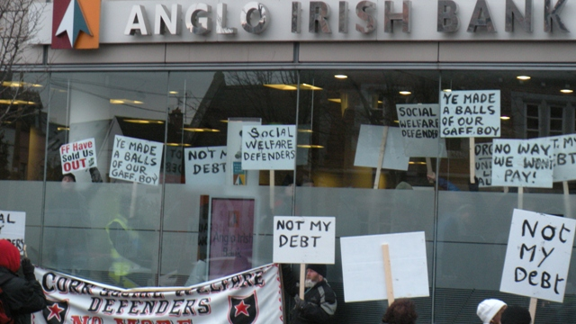
Ethical Issues & Conflict in Organisations
Tolerance for conflict
Manager with a high tolerance for conflict
  Keeps conflict levels too high for subordinates
Should such managers reveal their intentions about desired conflict levels?
Full disclosure
  Subordinates could leave the group if conflict levels became dysfunctionally stressful
Ethical question applies equally to newly hired employees

Slide 72
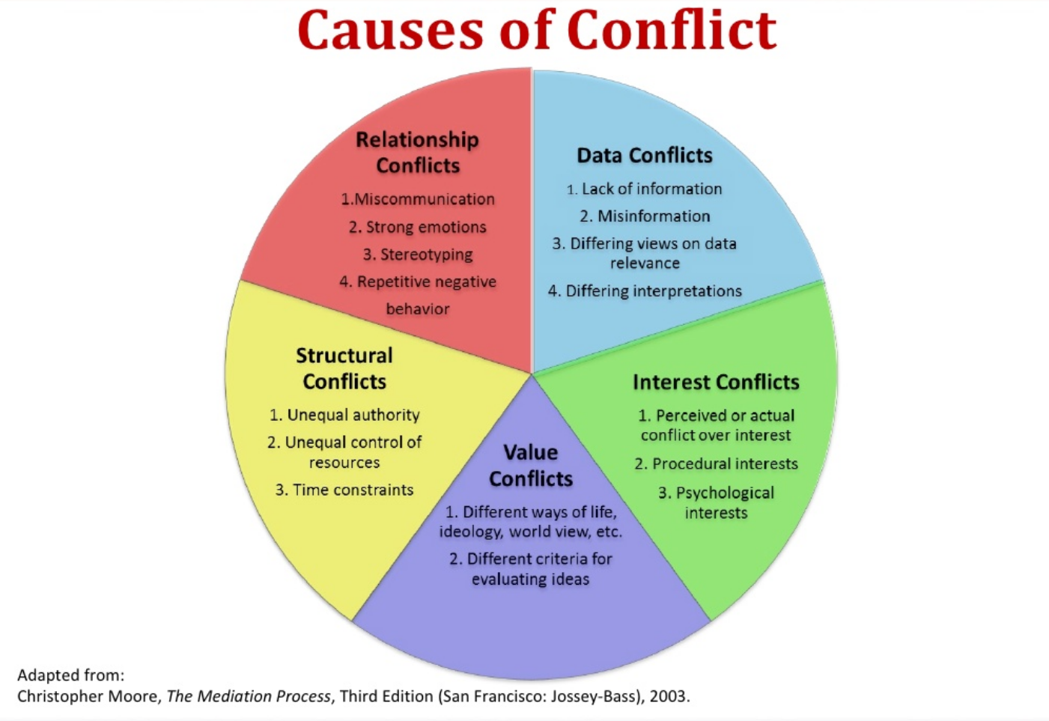
Ethical Issues & Conflict in Organisations
Deliberately increasing conflict is an effort to guide behaviour in a desired direction
Subtle methods of increasing conflict (forming heterogeneous groups) connote manipulation
Full disclosure: manager states his intention to use conflict to generate ideas and innovation
If people are free to join a group or not, the ethical issue likely subsides

Slide 73

Ethical Issues & Conflict in Organisations
Experiencing intrapersonal conflict
Requests to act against one's moral values
Observing behaviour that one considers unethical
Reduce intrapersonal conflict
Transfer to another part of the organisation
Report unethical acts
Quit
Fight Club: https://www.youtube.com/watch?v=l9EzK-719aE

Slide 74
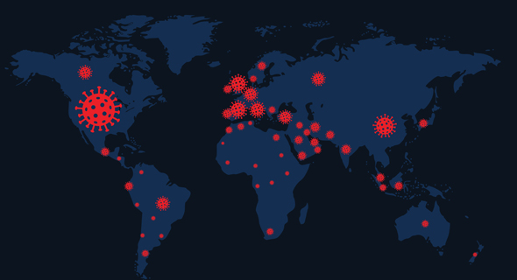
Culture & Conflict
Different cultures place different values on conflict
Optimal conflict levels vary among countries
Lower levels conflict in collectivistic countries than individualistic countries
Should managers honour such values even if their home country values support higher levels of conflict?
Individualism vs. Collectivism: How a country’s culture determined the severity of Covid-19 2021 Research from IDC Herzliya and Yale University

Slide 75

The Making of Modern Management
(Wilson & Thomson, 2005)
“The sociological, which maintains that most business problems cannot be solved unless people involved in them are taken into account along with technical and financial considerations.” Wilson & Thomson (2005)

Slide 76
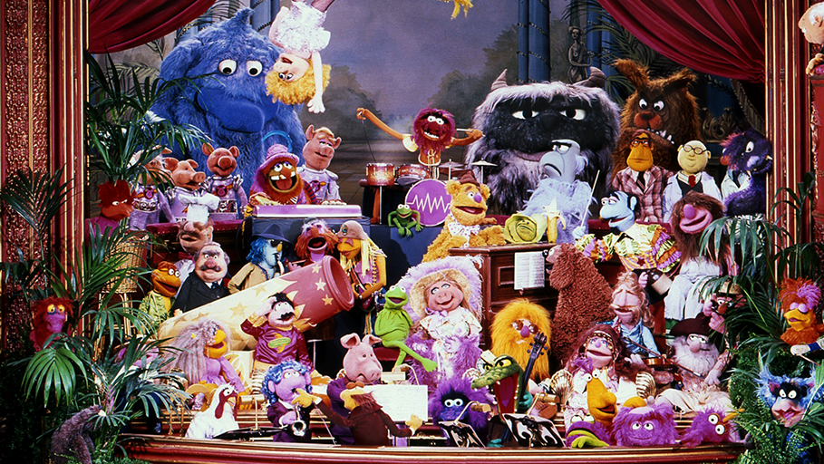
Conclusion
Staffing is the most vital asset with an organisation, without which it cannot move ahead in the competitive world. It can be equated with HR management as both have same sort of objectives
Staffing is an open system approach. It is carried out in the enterprise but is also linked to external environment

